Slide 1
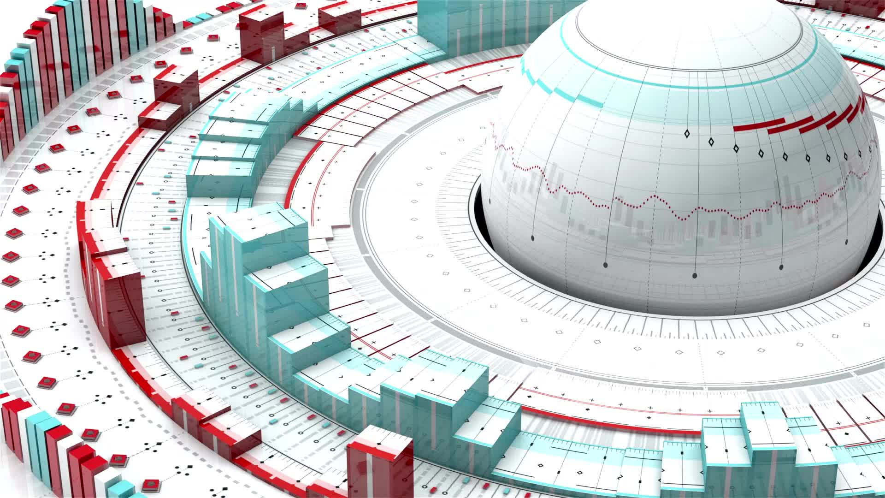
5G Core Architecture
Logan Chayet

Slide 2
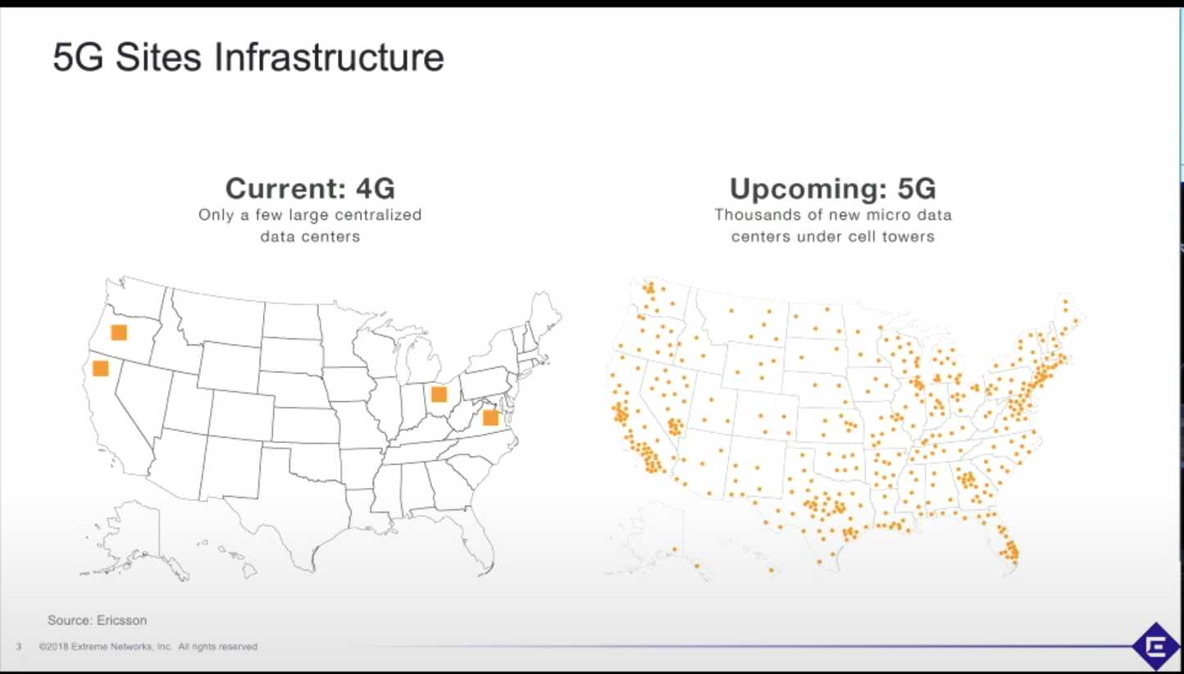
Comparing 5G to 4G
NFV/SDN Infrastructure
CI/CD Methodologies
Speed/Latency
Network Slicing
Micro Data Centers

Slide 3
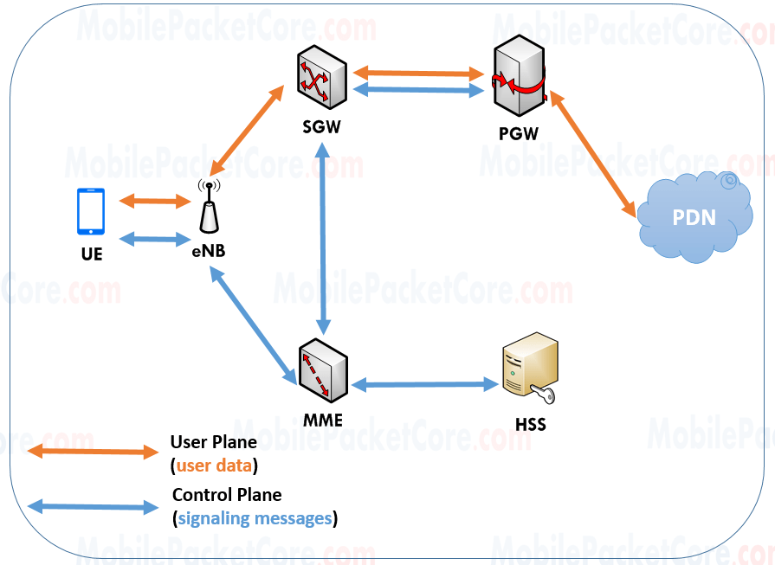

Slide 4
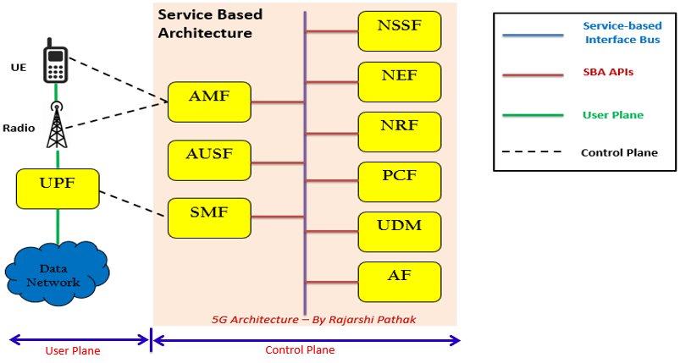

Slide 5
Implementing 5G And Its Applications
Non-standalone vs. Standalone implementation
Self-driving cars
Mission critical services

Slide 6

Thank you!
Questions?

